Slide 1
AREA FILLING ALGORITHMS

Slide 2
Approaches
Fill the interval of Scan line
Start from interior point until boundary
Methods
Scan line polygon fill
Scan line curve fill
Boundary fill
Flood fill

Slide 3
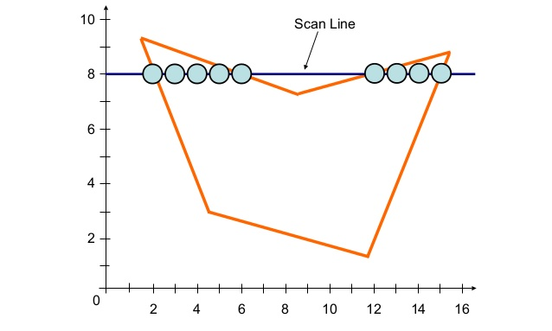
Scan line polygon fill

Slide 4
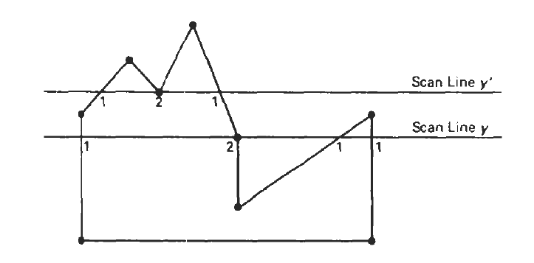

Slide 5
Intersection point is not a vertex
Intersection point is a vertex

Slide 6
How to find that an intersection point is a vertex?
v3
v2
Y values increase/decrease monotonically
v2 is single intersection point
Y
v1
X

Slide 7
How to find that an intersection point is a vertex?
Y values exhibit local extrema at shared vertex
v2 is double intersection point
v2
v1
v3
Y
v1
Y
v3
v2
X
X

Slide 8
Scan line curve fill
Find intersection points on the opposite sides

Slide 9
Boundary fill
Start from an interior point
Fill the neighbourhood point if
the point is not already filled
and
the point does not have the colour of the boundary

Slide 10
Flood fill
Start from an interior point
Fill the neighbourhood point if
the point is not already filled
and
the point has the predefined colour of the interior region

Slide 11
Area fill attributes

Slide 12
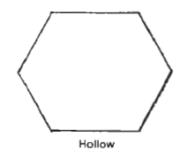
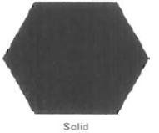



FILL STYLES

Slide 13
Pattern Array
1 | 2 | 1 | 2 | 1 | 2
2 | 1 | 2 | 1 | 2 | 1
1 | 2 | 1 | 2 | 1 | 2
2 | 1 | 2 | 1 | 2 | 1
1 | 2 | 1 | 2 | 1 | 2
2 | 1 | 2 | 1 | 2 | 1
1 | 2
2 | 1
1. Red
2. Green

Slide 14
Pattern Size
1 | 1 | 2 | 2 | 1 | 1
1 | 1 | 2 | 2 | 1 | 1
2 | 2 | 1 | 1 | 2 | 2
2 | 2 | 1 | 1 | 2 | 2
1 | 1 | 2 | 2 | 1 | 1
1 | 1 | 2 | 2 | 1 | 1
1 | 2
2 | 1
1. Red
2. Green
dx=2
dy=2

Slide 15
Set of parallel lines
Set of parallel lines crossing diagonally
Slope
Spacing

Slide 16
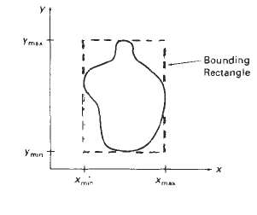
Pattern reference point
A staring position from where a pattern is replicated in X and Y direction until defined area is covered by non overlapping copies of pattern array.
Bottom of the bounding box

Slide 17

Implementation of patterned fill

Slide 18
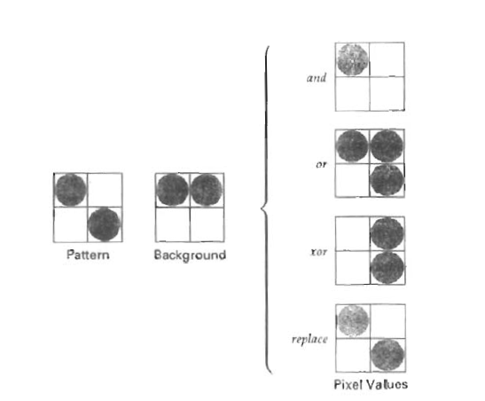
Pattern combined with background colour

Slide 19
Soft fill
Fill colour is combined with background colour
Linear Soft fill

Slide 20
Combining more than one background colour

Slide 21
END OF CHAPTER

